Slide 1



Dip in 7
Lesson 6
Association game 1

Slide 2

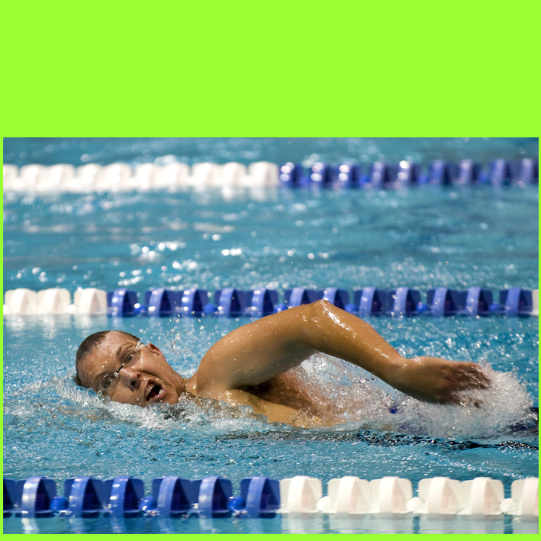
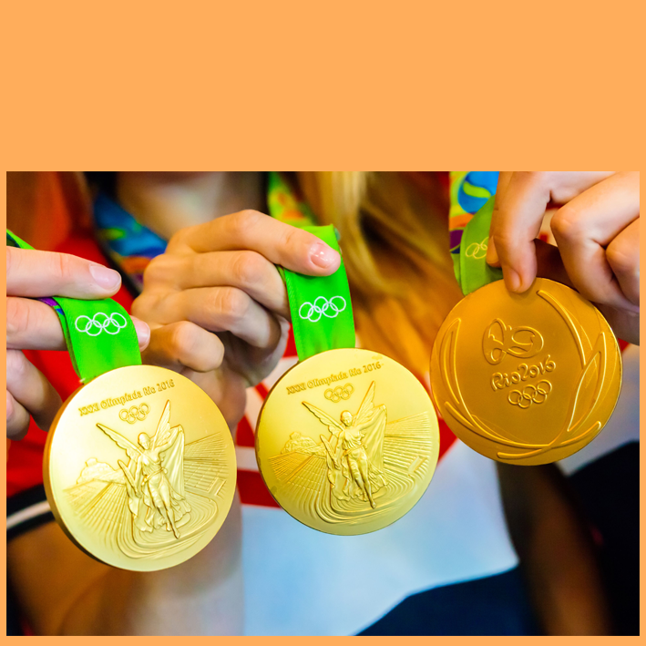


A1
a country
B1
lanes
C1
7×4
D1
…Jackson
stars
suit
gold
A2
B2
C2
D2
…Fassbender
50 states
water
silver
…Jordan
A3
B3
C3
D3
A4
stripes
B4
pool
C4
bronze
George…
D4
COLUMN A
COLUMN C
THE USA
COLUMN B
28 MEDALS
SWIMMING
MICHAEL
COLUMN D
THE FINAL ANSWER
MICHAEL PHELPS

